Slide 1
Longitude and Latitude EQ: Why do we have longitude and latitude lines?
Mrs James
Year 12 Essentials

Slide 2
https://www.youtube.com/watch?v=cTrsvGytGG0

Slide 3
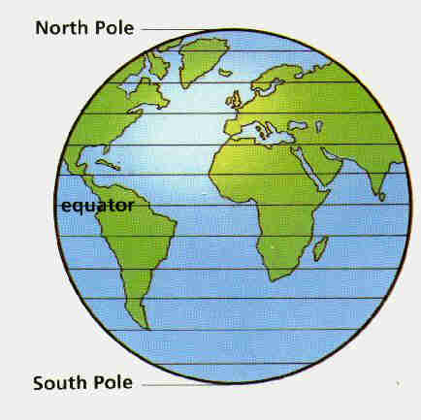
24
7
30
Longitude and Latitude
Date
EQ – Why do we have longitude and latitude lines?
Lines of Latitude
0 degrees latitude is called the equator.
Other lines of latitude are north or south of the equator.

Slide 4
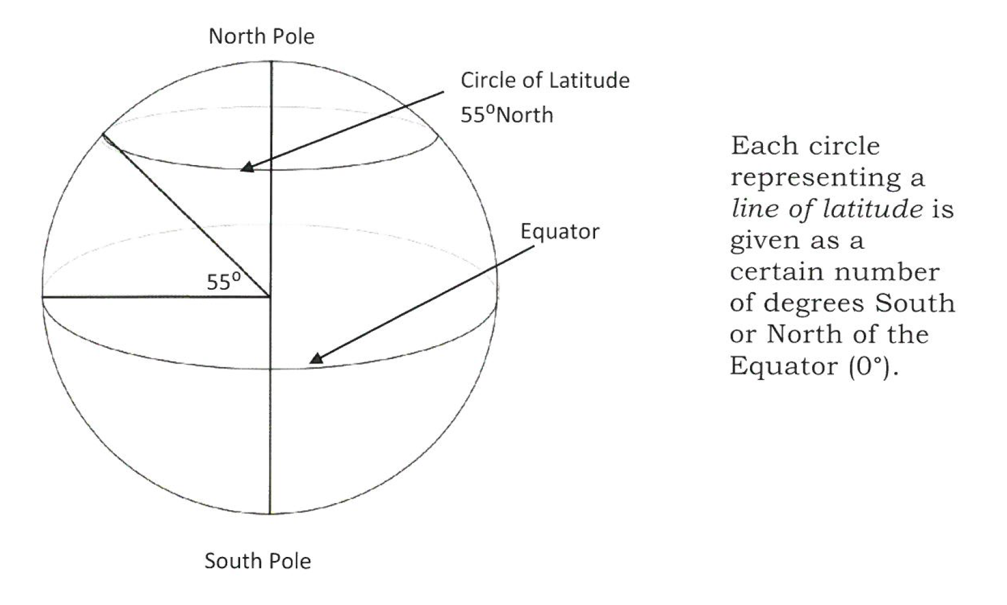

Slide 5
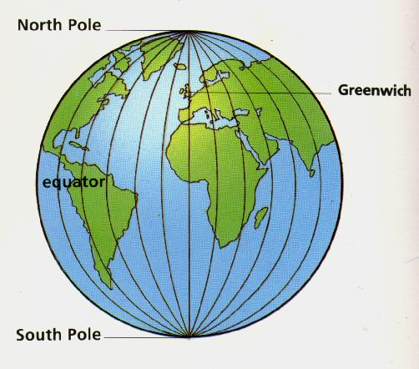
24
7
30
Longitude and Latitude
Date
EQ – Why do we have longitude and latitude lines?
Lines of Longitude
0 degrees longitude is called the Greenwich Meridian.
Other lines of Longitude are West or East of the Greenwich Meridian.

Slide 6
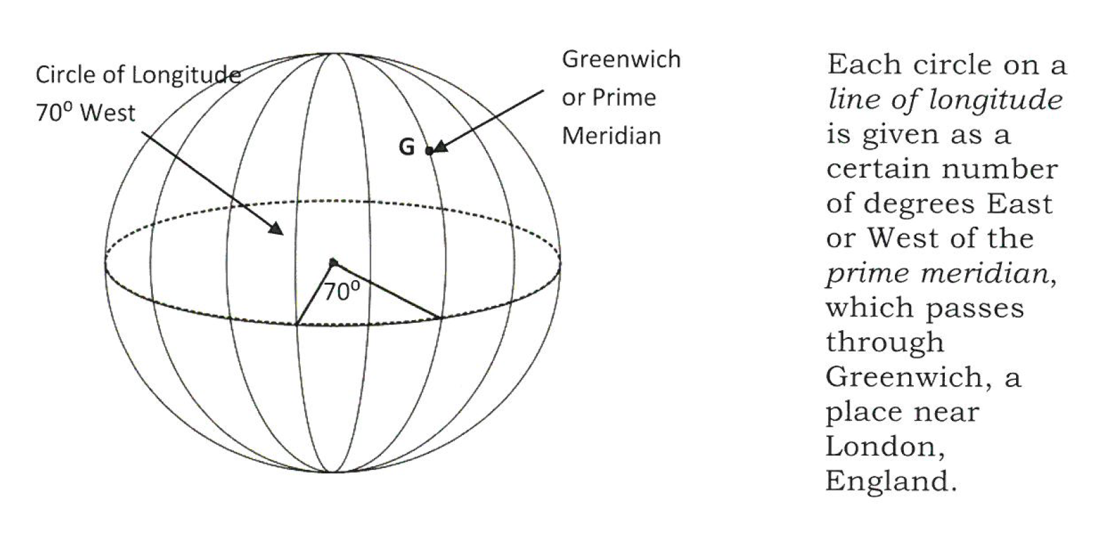

Slide 7
Latitude plus Longitude give us the earth’s grid.

Slide 8
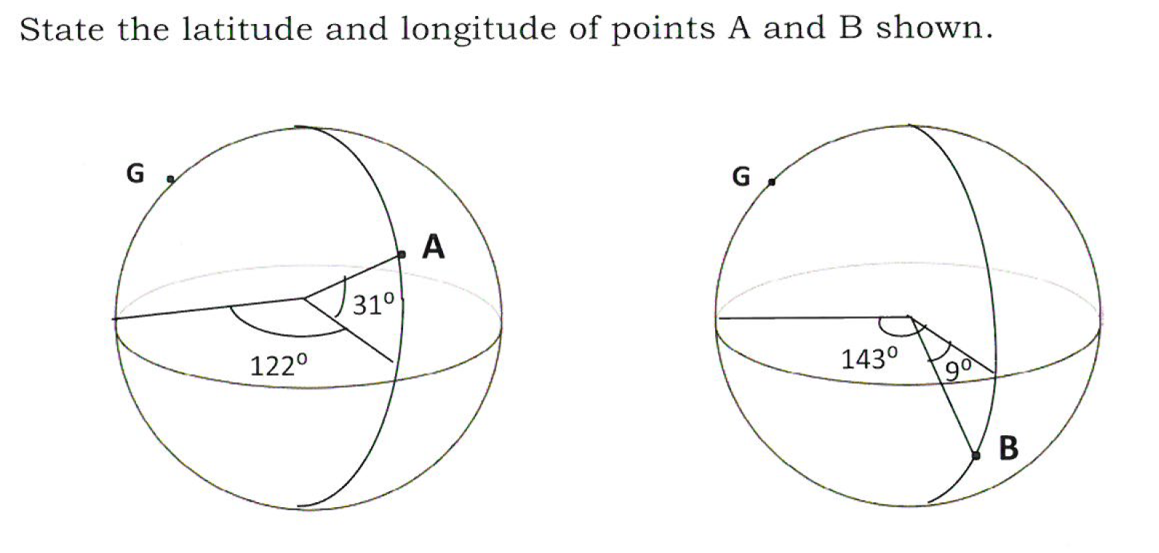
Task
Notes:
HINT: when giving a co-ordinate, latitude (north or south) always precedes longitude (east or west)
A= 31N 122E
B= 9S 143E

Slide 9
Task
Grab world Map worksheet- check how you label longitude ( east or west)
Complete Positions on the globe time trial with a partner- 12mins!
Who got the quickest time?
Who was the most accurate?
Notes:
HINT: when giving a co-ordinate, latitude (north or south) always precedes longitude (east or west)
A= 31N 122E
B= 9S 143E

